Slide 1

Wireless Networks
ICT-4107
By-
Dr. Jesmin Akhter
Professor
Institute of Information Technology
Jahangirnagar University

Slide 2
Contents
The course will mainly cover the following topics:
Wireless Networking
Multiple Access techniques
FDMA, TDMA and CDMA systems
Modulation Techniques
Analog and digital modulation techniques, Performance of various modulation techniques - Spectral efficiency, Error rate
The Cellular Concepts and System Design Fundamentals
Cellular concept and frequency reuse, Channel assignment and handoff, Interface and system capacity, Trunking and Erlang capacity calculations
Mobile Radio Propagation
Radio wave propagation issues in personal wireless systems, Propagation models, Multipath fading, Parameters of mobile multipath channels, Antenna systems in mobile radio.
Cellular Wireless Networks
Principles of Cellular Networks
First-Generation Analog
Second-Generation TDMA
Second-Generation CDMA
Third-Generation Systems

Slide 3
Outline
Mobile Radio Propagation
Propagation models,
Parameters of mobile multipath channels,

Slide 4
Radio Propagation
Radio propagation is the behavior of radio waves as they travel, or are propagated, from one point to another, or into various parts of the atmosphere.
As a form of electromagnetic radiation, like light waves, radio waves are affected by the phenomena of reflection, diffraction and scattering.
Notes:
https://www.geeksforgeeks.org/modes-of-radio-wave-propagation-in-wireless-communication/

Slide 5
Radio Propagation
Radio propagation in urban areas is quite complex because it often consists of reflected and diffracted waves produced by multipath propagation.
Radio propagation in open areas free from obstacles is the simplest to treat, but, in general, propagation over the earth and the water invokes at least one reflected wave.
when the environmental structure is random, the Rayleigh model used for urban area propagation may be applied.
When the propagation path is on line of sight, as in tunnel and underground passages, the environment may be treated either by the Rician model. Direct wave models may be used for propagation in a corridor.

Slide 6
Radio Propagation
In general, radio wave propagation consists of three main attributes: reflection, diffraction and scattering
Reflection occurs when radio wave propagating in one medium impinges upon another medium with different electromagnetic properties.
The amplitude and phase of the reflected wave are strongly related to the medium’s instrinsic impedance, incident angle, and electric field polarization. Part of the radio wave energy may be absorbed or propagated through the reflecting medium, resulting in a reflected wave that is attenuated.

Slide 7
Radio Propagation
Diffraction is a phenomenon by which propagating radio waves bend or deviate in the neighborhood of obstacles. Diffraction results from the propagation of waves into a shadowy region caused by obstructions such as walls, buildings, mountains, and so on.
Scattering occurs when a radio signal hits a rough surface or an object having a size much smaller than or on the order of the signal wavelength. This causes the signal energy to spread out in all directions. Scattering can be viewed at the receiver as another radio wave source. Typical scattering objects are furniture, lamp posts, street signs, and foliage.
Notes:
Foliage -plant leaves collectively.

Slide 8
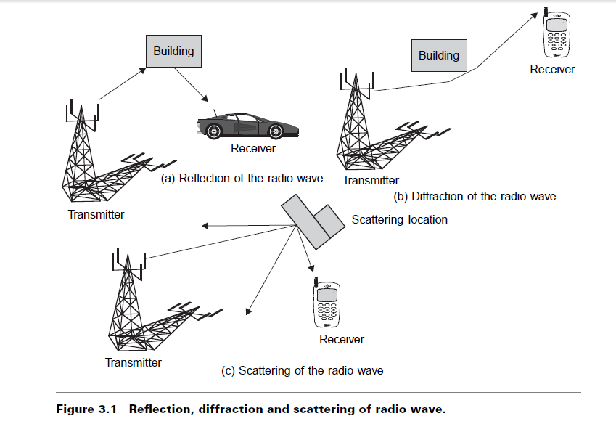
Radio Propagation

Slide 9
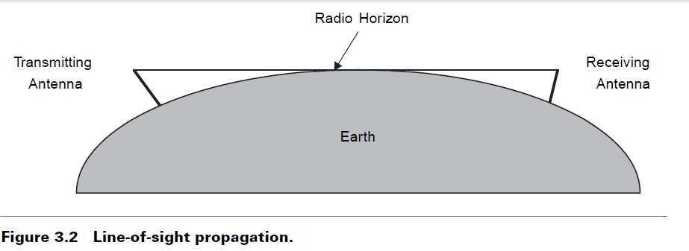
Free-Space Attenuation
The most simple wave propagation case is that of a direct wave propagation in free space. In this special case of line-of-sight (LOS) propagation there are no obstructions due to the earth’s surface or other obstacles.
We consider radiation from an isotropic antenna. This type of antenna is completely omni-directional, radiating uniformly in all directions.
Line-of-sight propagation means radio waves which travel in a straight line from the transmitting antenna to the receiving antenna. Line of sight transmission is used to medium range radio transmission such as cell phones, cordless phones, walkie-talkies, wireless networks, FM radio and television broadcasting and radar, and satellite communication, such as satellite television.

Slide 10
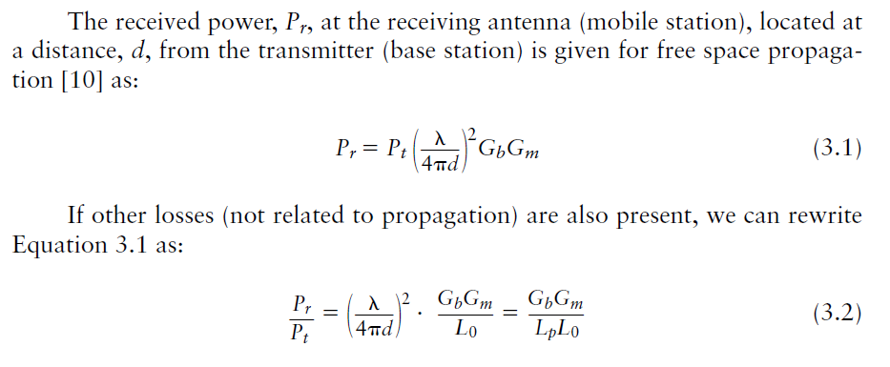
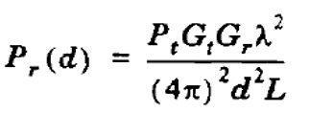
Free-Space Attenuation
The free space power received by a receiver antenna which is separated from a radiating transmitter antenna by a distance d, is given by the Friis free space equation:
Friis free space Path Loss Model
Friis free space propagation model is used to model the line-of-sight (LOS) path loss incurred in a free space environment, barren of any objects that create absorption, diffraction, reflections, or any other characteristic-altering phenomenon to a radiated wave.

Slide 11
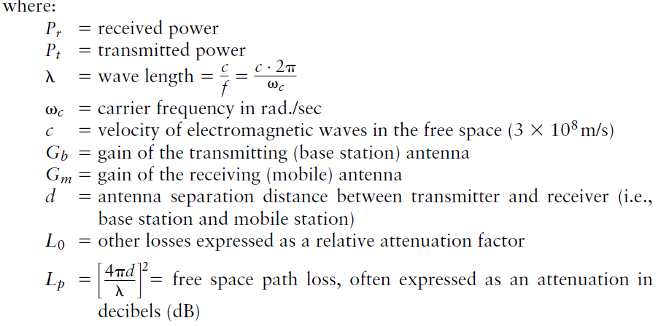
Free-Space Attenuation

Slide 12
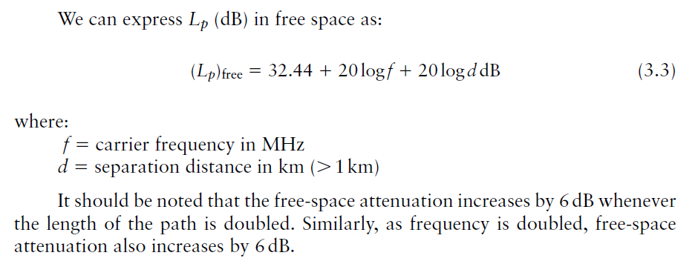
Free-Space Attenuation
If frequency and distance is considered as MHz and Kilometers then,

Slide 13
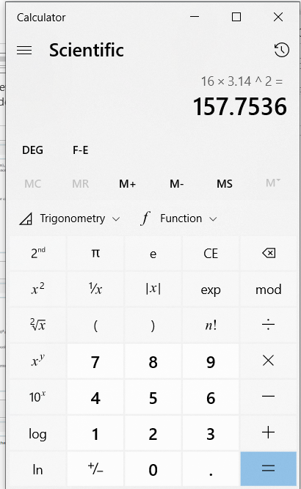
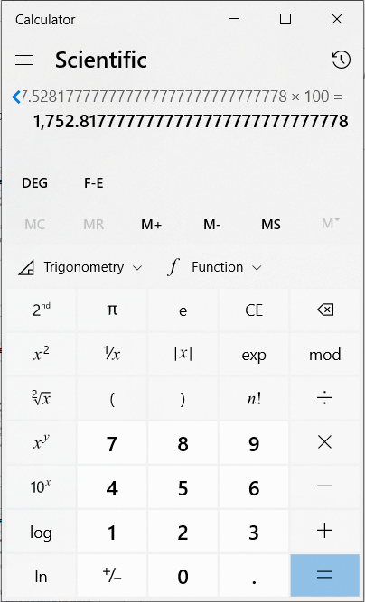
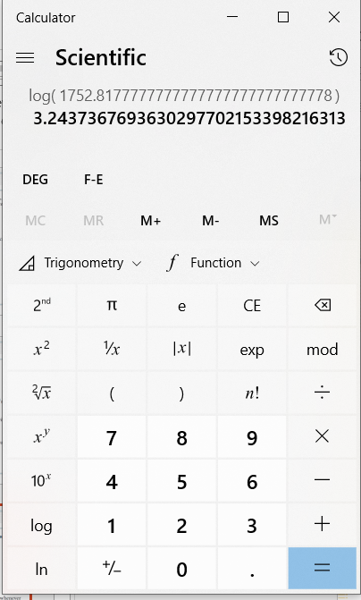
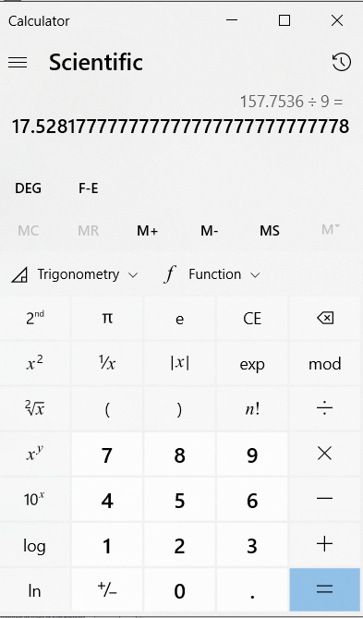
10*3.2437=32.44

Slide 14
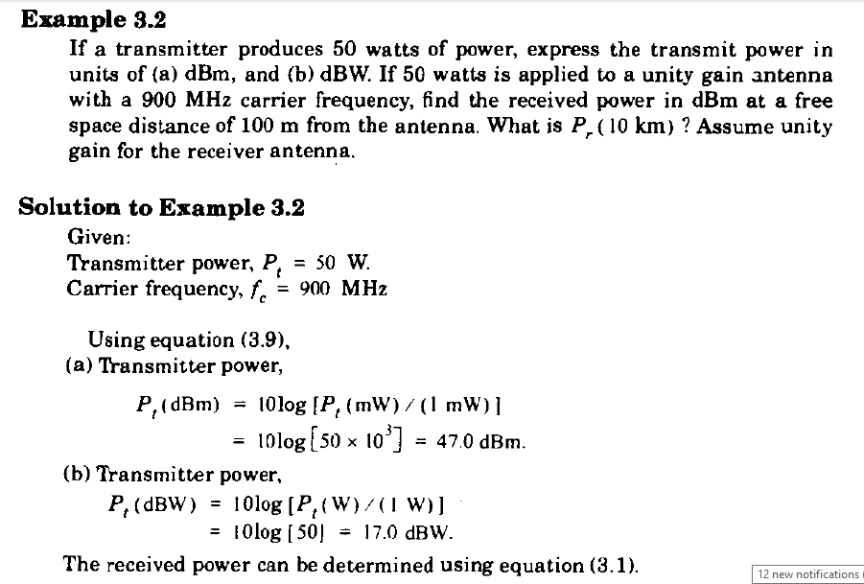

Slide 15
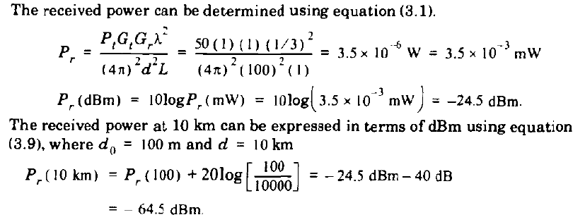

Slide 16
Characteristics of Wireless Channel/ Parameters of mobile multipath channels
The wireless channel is different and much more unpredictable than the wireline channel because of factors such as
multipath and shadow fading,
Doppler shift,
and time dispersion or delay spread.
These factors are all related to variability introduced by mobility of the user and the wide range of environmental conditions.
Notes:
https://mucertification.com/topic/2-2-b-parameters-of-mobile-multipath-channels/

Slide 17
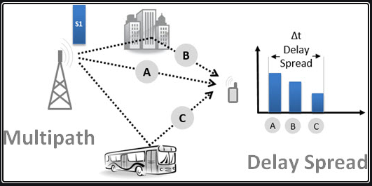
DELAY SPREAD
Multipath delays occur as a transmitted signal is reflected by objects in the environment between a transmitter and a receiver. These objects can be buildings, trees, hills, or even trucks and cars.
In the figure, the transmitter transmits a single signal. This signal is propagated along different paths (A, B and C), and eventually reaching the receiver at multiple time instants, and therefore with multiple "replication” that is multiple copies of the signal are received at the receiver at different moments.
The signal on the shortest path(typically LOS) reaches first than those on longer paths. The direct effect of this different arrivals of signal causes the spread of the original signal in time domain. This spread is called the DELAY SPREAD
The total elapsed time between the first and last is determined by the environment (including the structures, how close they are, etc..). For example, in an urban environment, where the reflection is high (many buildings, many vehicles parked and moving), this delay has a typical value of 5-10 microseconds.
Notes:
A transmitted symbol can be received multiple times at the receiver, more or less as an "echo" effect. This echo is what we call "Delay Spread".

Slide 18
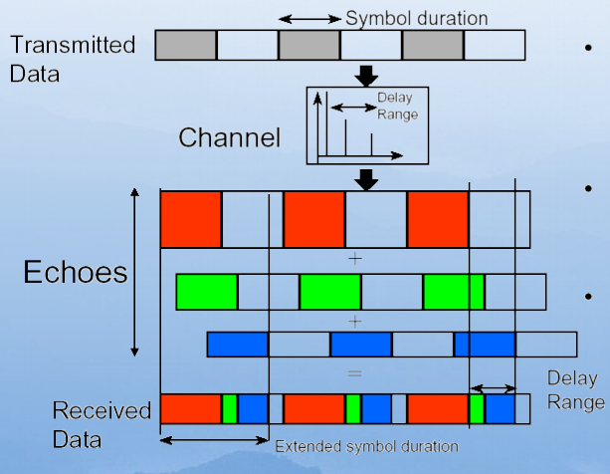
DELAY SPREAD
Notes:
smeared

Slide 19
DELAY SPREAD
The time delay is the difference in travel time between multipath arrivals and can be used to extract certain channel's parameters such as the delay spread. So Delay spread is a measure of the multipath profile of a mobile communications channel.
It is generally defined as the difference between the time of arrival of the earliest component (the line-of-sight wave if there exists) and the time of arrival of the last multipath component. That is the time between the reception of the first version of the signal and the last echoed signal is called delay spread.
The delay spread is mostly used in the characterization of wireless channels, but it also applies to any other multipath channel (e.g. multipath in optical fibers).
Maximum Delay Spread=Delay between
first and last arriving component.
g₁
Impulse Response
g₂
g₄
g₃
τ₀=0 µs
τ₁
τ₂
τ₃
Delay time
Notes:
an impulse response is the reaction of any dynamic system in response to some external change. It describes the reaction of the system as a function of time

Slide 20
How to characterize the delay spread?
If First arriving component is τ_{0 and} last arriving component is τ_{L-1} then
Maximum Delay Spread=σ_{τ(Max)}= τ_{L-1} -τ₀
Example Consider a multipath channel with L=4 components where First arriving component τ₀=0 microseconds and Last arriving component τ_{L-1=} 5 microseconds
Maximum Delay Spread=σ_{τ(Max)}= τ_{L-1} -τ₀=5-0=5 microseconds.

Slide 21
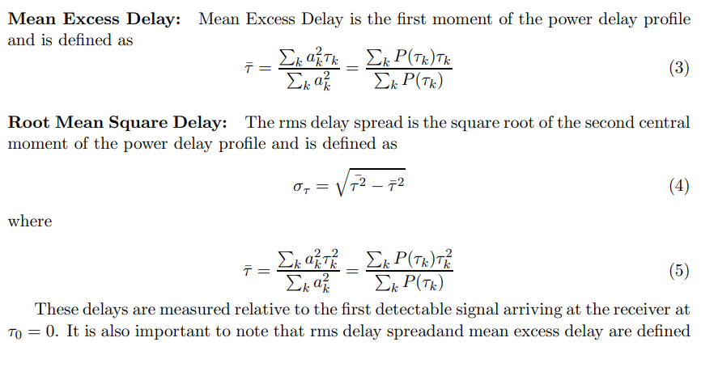
Notes:
A multipath channel can be characterized in multiple ways for deterministic modeling and power delay profile (PDP) is one such measure. In a typical PDP plot, the signal power on each multipath is plotted against their respective propagation delays. A sample power delay profile plot, indicates how a transmitted pulse gets received at the receiver with different signal strengths as it travels through a multipath channel with different propagation delays.
Knowledge of the delay spread is essential in system design for determining the trade-off between the symbol rate of the system and the complexity of the equalizers at the receiver. The ratio of RMS delay spread () and symbol time duration () quantifies the strength of intersymbol interference (ISI). Typically, when the symbol time period is greater than 10 times the RMS delay spread, no ISI equalizer is needed in the receiver. The RMS delay spread obtained from the PDP must be compared with the symbol duration to arrive at this conclusion.

Slide 22
Example (Power delay profile)
P_{r}(τ)
4.38 µs
1.37 µs
0 dB
-10 dB
-20 dB
-30 dB
τ
0
1
2
5
(µs)

Slide 23
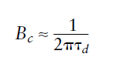
Coherence Bandwidth
The delay spread parameters are used to characterize the channel in the time domain.
In the frequency domain the channel is characterized by the coherence bandwidth , B_{c}, which is the range of frequencies over which the signal strength remains more or less unchanged.
It is a statistical measure of the range of frequencies over which the channel can be considered "flat" (i.e., a channel which passes all spectral components with approximately equal gain and linear phase);
The coherence bandwidth (B_{c}) between two frequency envelopes is given as
Where τ_{d} is the rms delay spread in multipath delay.
Channel frequency Response H(f)
B_{c}
Frequency Separation

Slide 24
Coherence Bandwidth
In order to avoid channel-induced ISI distortion, the channel is required to be flat fading by ensuring that Bc > B_{w}.
Thus, the channel coherence bandwidth sets an upper limit on the transmission rate that can be used without incorporating an equalizer in the receiver.

Slide 25
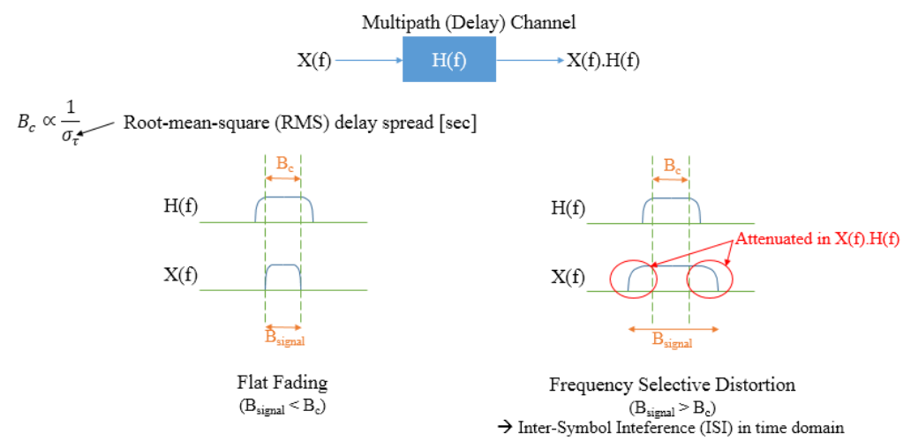
Coherence Bandwidth
Notes:
The channel output can be expressed as the convolution of input signal and the channel impulse response , plus some noise .
The impulse response can be thought of as an "influence function": how a point of input influences output.

Slide 26
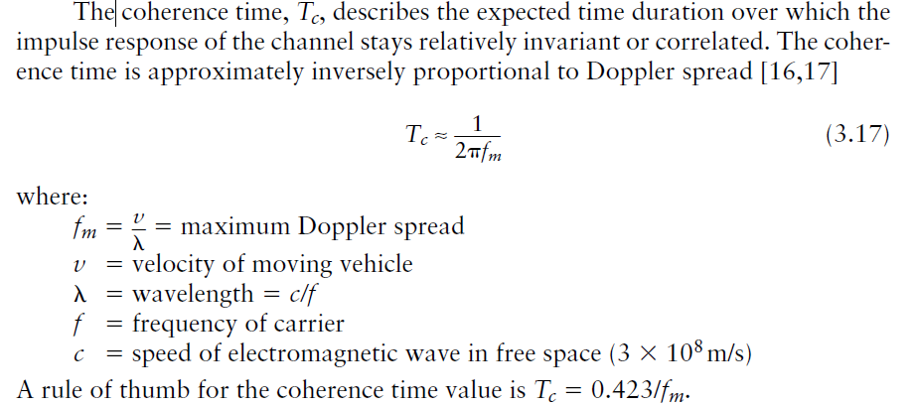
Coherence Time
Notes:
The impulse response can be thought of as an "influence function": how a point of input influences output.

Slide 27
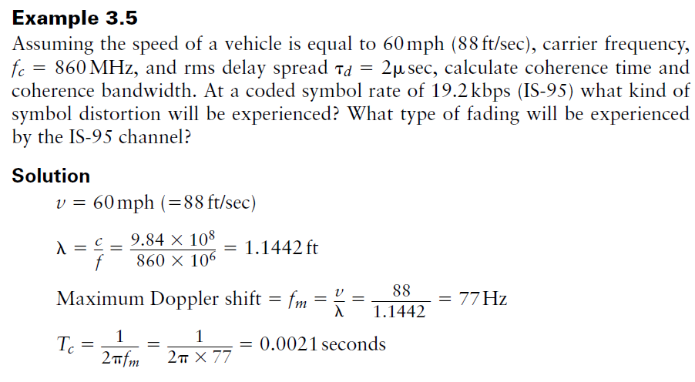
1 m=3.2808 ft,3X 10⁸ m/sec=9.84X 10⁸ ft/sec
=2100 microsec

Slide 28
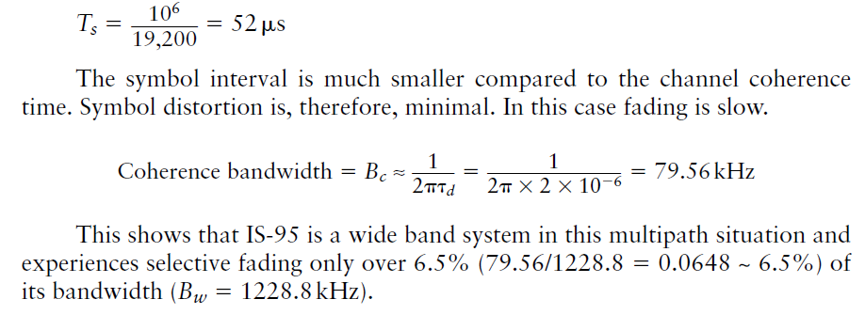

Slide 29
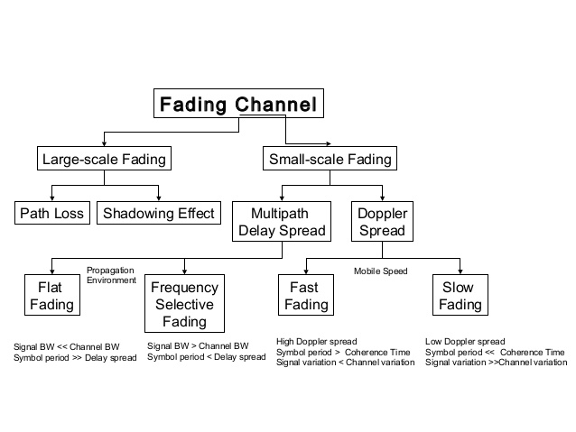

Slide 30
Small scale fading
B_{S}
Flat fading
B_{C}
Multi path time delay
B_{S}
Frequency selective fading
B_{C}
fading
T_{S}
Fast fading
T_{C}
Doppler spread
Slow fading
T_{S}
T_{C}

Slide 31
Frequency selective fading
If the bandwidth of the transmitted signal has a bandwidth(B_{w}) greater than coherence bandwidth(B_{c}), then it undergoes frequency selective fading ie. a channel is a frequency-selective channel if B_{w} > B_{c} .
Frequency selective distortion occurs whenever a signal’s spectral components are not all affected equally by the channel.
Consequently, the received signal contains multiple versions of the transmitted waveform which are attenuated and delayed in time and hence the received signal is distorted.
Thus, frequency selective fading is a result of the time dispersion of the transmitted symbol within the channel.
The symbol gets spread out in time resulting in Intersymbol Interference (ISI) .
The energy from one symbol spills over into another symbol, thereby increasing the bit-error-rate (BER).
In the case of frequency selective fading, the delay spread exceeds the symbol duration.

Slide 32
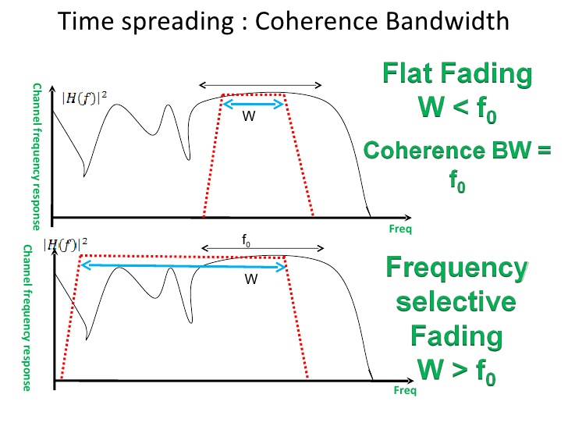
Frequency selective fading VS Flat fading

Slide 33
Flat fading
when there is no dispersion and delay spread is less than the symbol duration, the fading will be flat, thereby affecting all frequencies in the signal equally.
When the coherence bandwidth of the channel is larger than the bandwidth of the signal and therefore, all frequency components of the signal will experience the same magnitude of fading the fading will be flat.
In flat fading there is no dispersion and
Delay spread is less than the symbol duration
Flat fading can lead to deep fades of more than 30 to 40 dB.

Slide 34
Doppler shift
Doppler shift is the random changes in a channel introduced as a result of a mobile user’s mobility.
When a user (or reflectors in its environment) is moving, the user's velocity causes a shift in the frequency of the signal transmitted along each signal path. This phenomenon is known as the Doppler shift
Since fading depends on whether signal components add constructively or destructively, such channels have a very short coherence time.
Doppler spread has the effect of shifting or spreading the frequency components of a signal. This is described in terms of frequency dispersion.

Slide 35
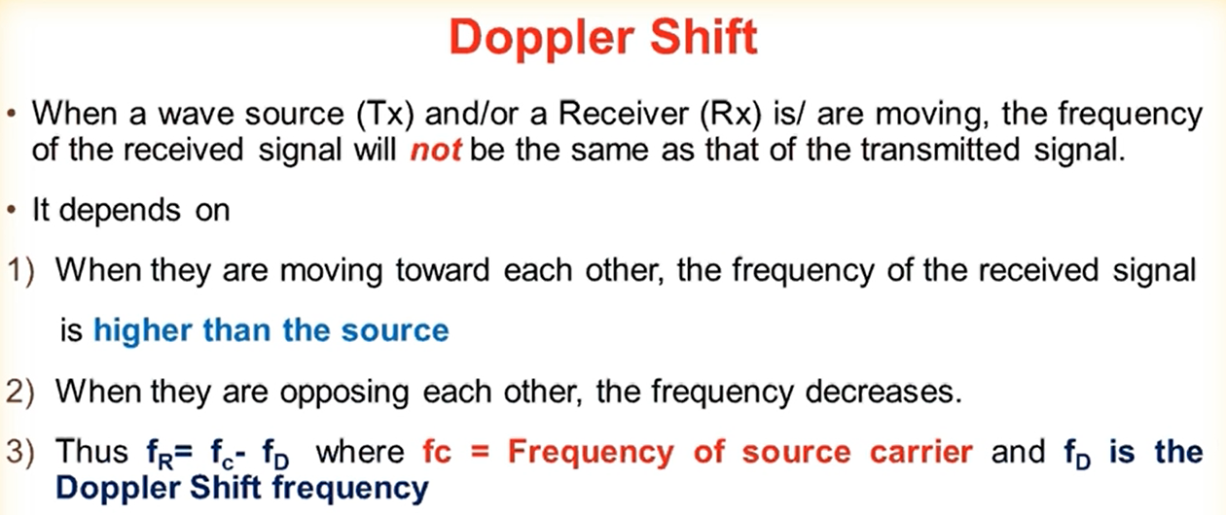

Slide 36
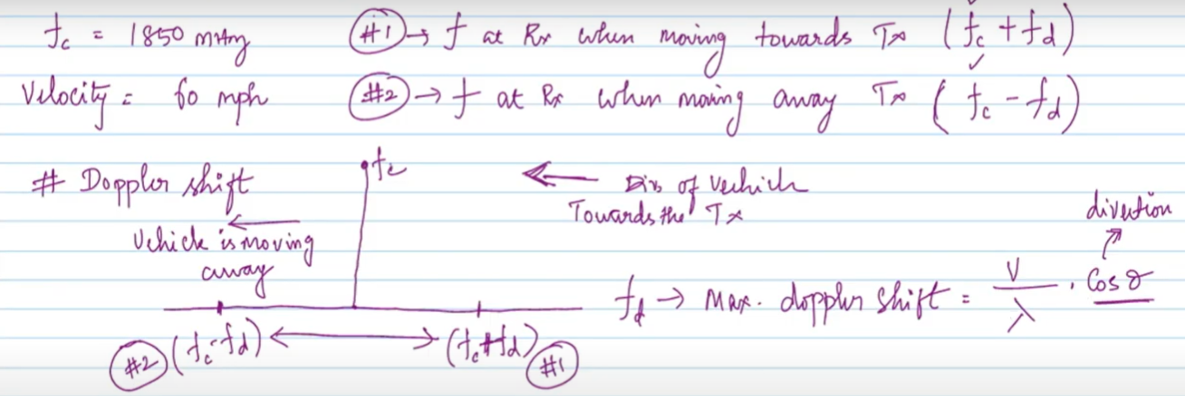
Doppler shift

Slide 37
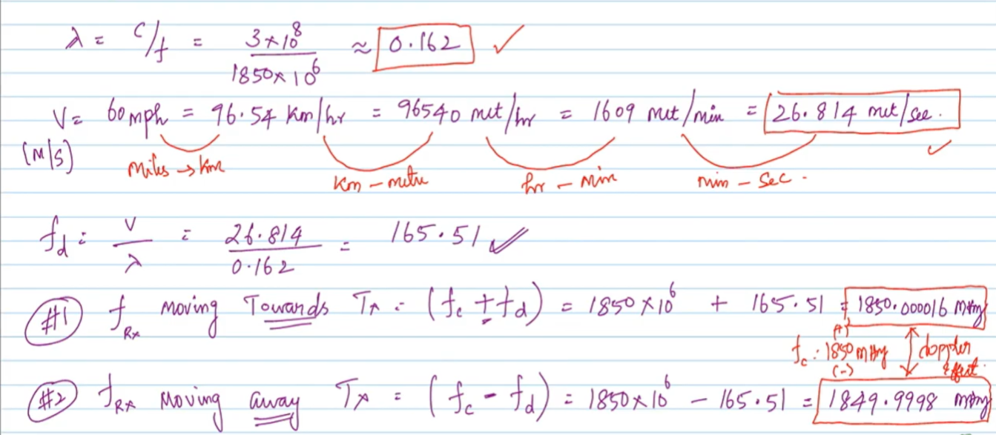
Doppler shift

Slide 38
Fast fading
If the transmitted symbol interval, T_{s} , exceeds T_{c} , then the channel will change during the symbol interval and symbol distortion will occur.
In such cases, a matched filter is impossible without equalization and correlator losses occur.
If the signal symbol interval T_{s} » T_{c} , the channel changes or fades rapidly compared to the symbol rate. This case is called fast fading and frequency dispersion occurs, causing distortion.

Slide 39
Slow fading
If T_{s} « T_{c} the channel does not change during the symbol interval. This case is called slow fading.
Thus, to avoid signal distortion caused by fast fading, the channel must be made to exhibit slow fading by ensuring that the signaling rate exceeds the channel fading rate Ts < Tc.

Slide 40
Thank You

Slide 41
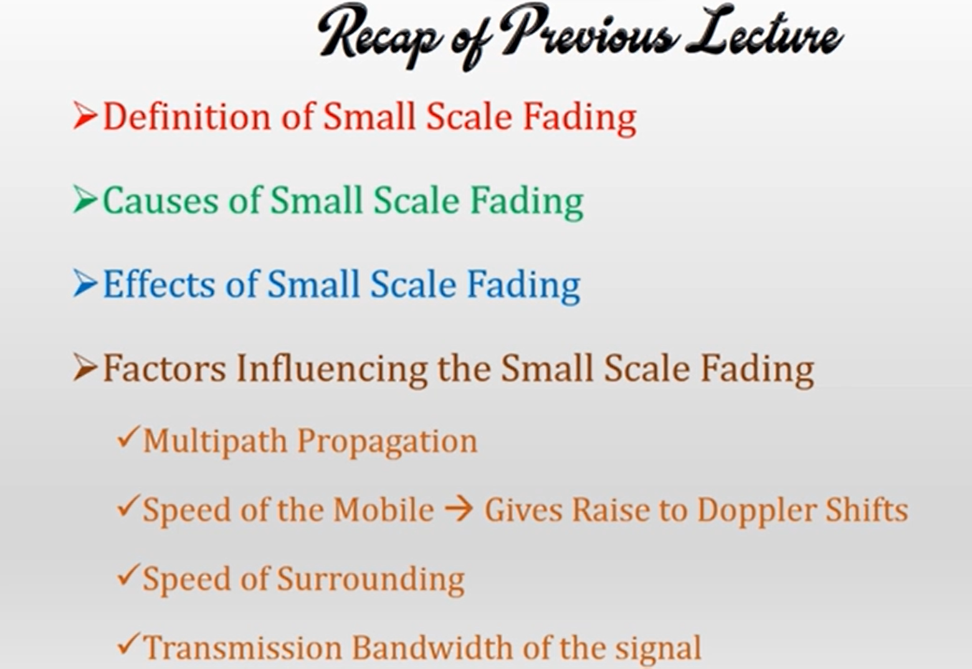
Notes:
https://mucertification.com/topic/2-2-b-parameters-of-mobile-multipath-channels/

Slide 42
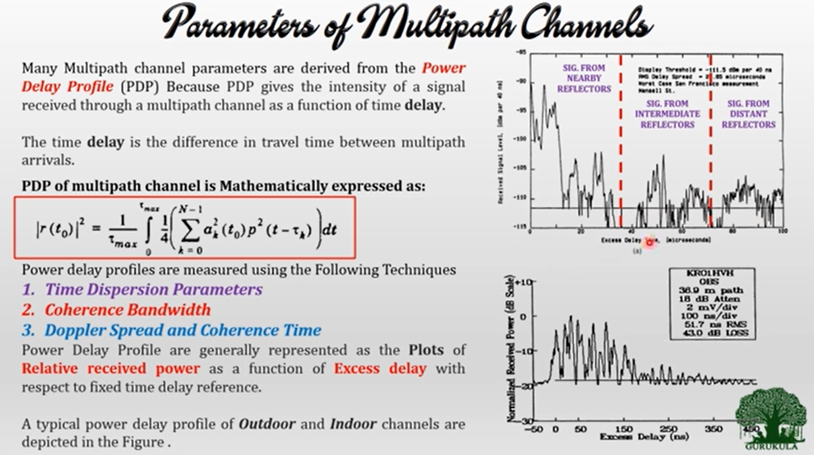

Slide 43
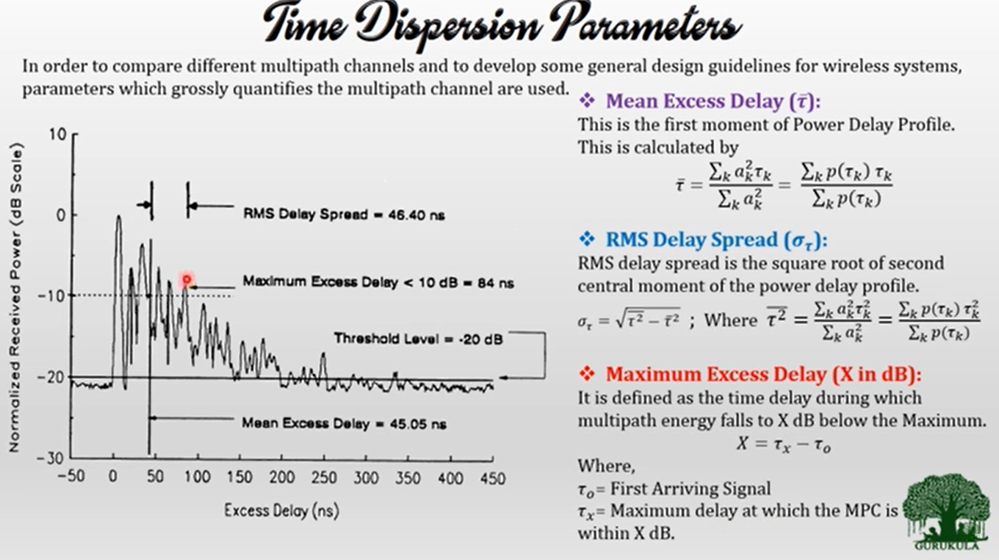

Slide 44
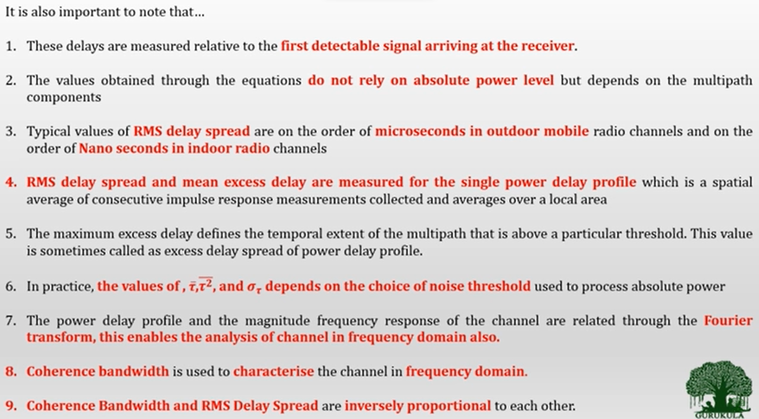

Slide 45
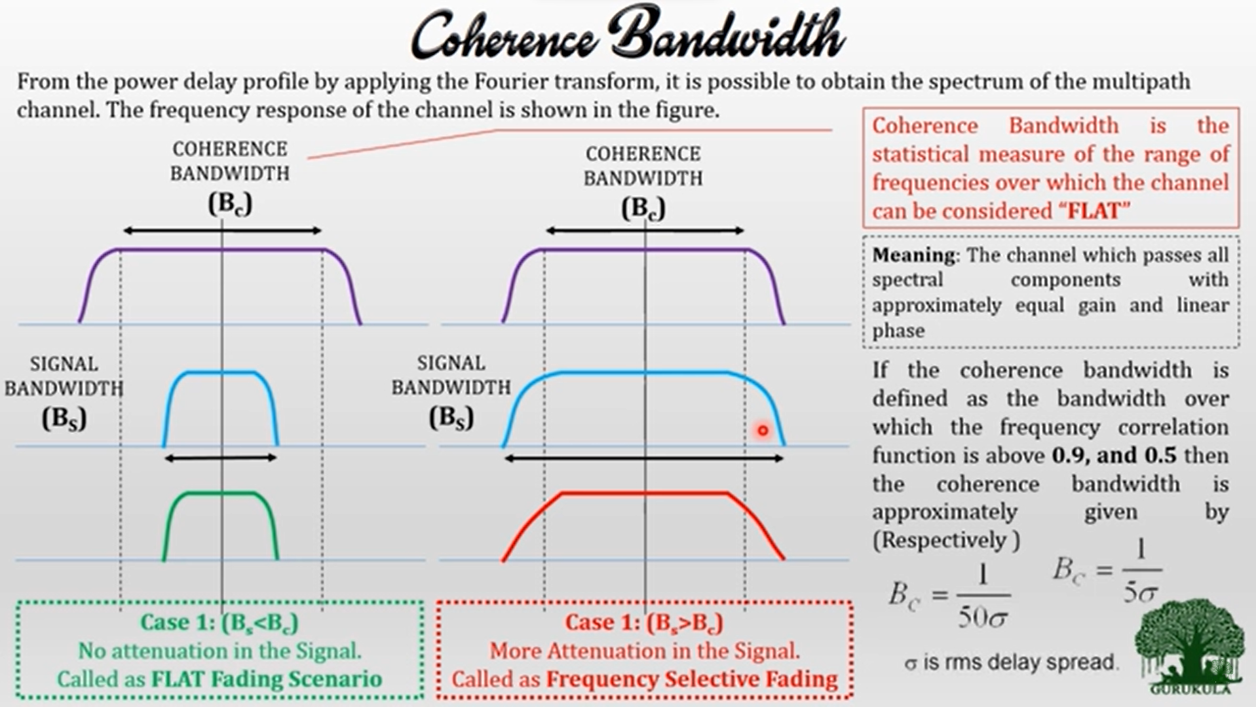

Slide 46
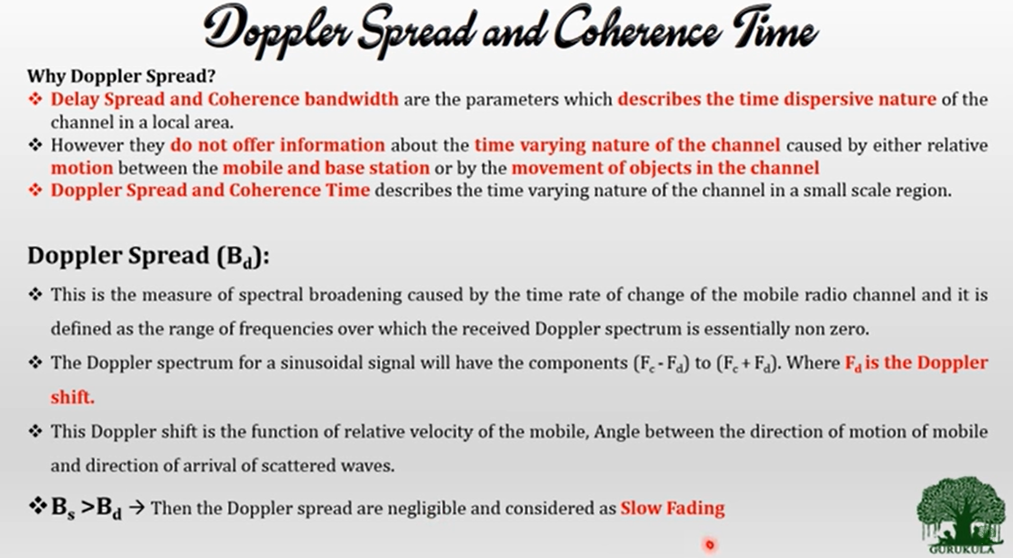

Slide 47
